Slide 1

Functions Cont.
Mina Gabriel

Slide 2
Input from Keyboard
There are hardly any programs without any input.
Input can come in various ways, for example from a database, another computer, mouse clicks and movements or from the internet. Yet, in most cases the input stems from the keyboard.
For this purpose, Python provides the function input(). input has an optional parameter, which is the prompt string.
name = input(“What is your name?”)

Slide 3
If the input function is called, the program flow will be stopped until the user has given an input and has ended the input with the return key. The text of the optional parameter, i.e. the prompt, will be printed on the screen.
The input of the user will be interpreted. If the user e.g. puts in an integer value, the input function returns this integer value. If the user on the other hand inputs a list, the function will return a list.

Slide 4
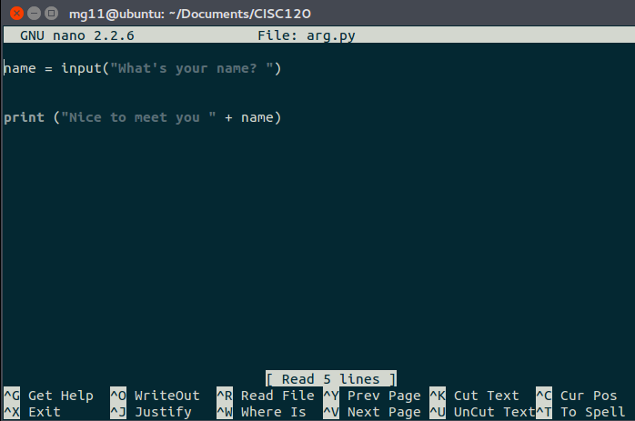
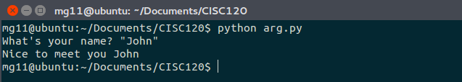
Example

Slide 5
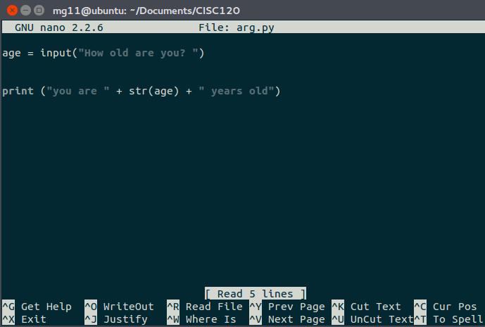
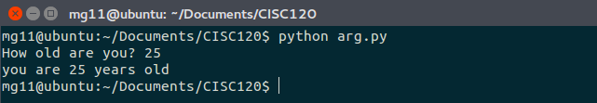
Example

Slide 6
Exercise |
prompt the user to enter two numbers and display their total.

Slide 7
Exercise II
Create a python program to ask the user to enter their name and student id and display the following message to the screen:
“your name is $Student_name and your student id is $Student_ID”

Slide 8
Return Functions and Void Functions
Some of the functions we have used, such as the math functions, return results; Other functions, like functions that only print , perform an action but don’t return a value. They are called void functions.

Slide 9
When you call a fruitful function, you almost always want to do something with the result; for example, you might assign it to a variable or use it as part of an expression:
x = math.cos(radians)
golden = (math.sqrt(5) + 1) / 2

Slide 10
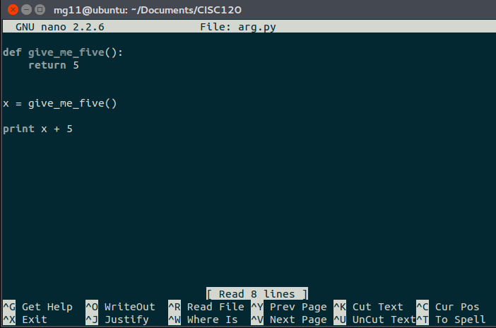
Example

Slide 11
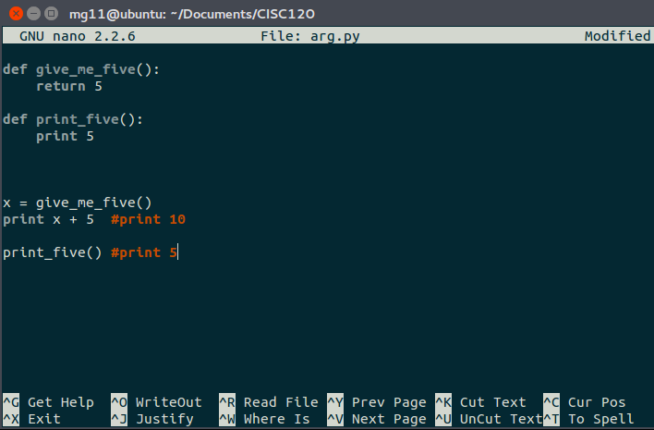
see the difference between void fun and fun that return value

Slide 12
Glossary
function:
A named sequence of statements that performs some useful operation. Functions may or may not take arguments and may or may not produce a result.
function definition:
A statement that creates a new function, specifying its name, parameters, and the statements it contains.
function object:
A value created by a function definition. The name of the function is a variable that refers to a function object.
header:
The first line of a function definition.
body:
The sequence of statements inside a function definition.
parameter:
A name used inside a function to refer to the value passed as an argument.

Slide 13
function call:
A statement that runs a function. It consists of the function name followed by an argument list in parentheses.
argument:
A value provided to a function when the function is called. This value is assigned to the corresponding parameter in the function.
local variable:
A variable defined inside a function. A local variable can only be used inside its function.
return value:
The result of a function. If a function call is used as an expression, the return value is the value of the expression.
return function:
A function that returns a value.
void function:
A function that always returns None.

